Slide 1
An introduction to web development
Jan Czarnecki
2018-02-06
Notes:
Hello, I’m Jan Czarnecki and today I’m going to talk about how to get started with web development. I’ve aimed this talk at people who have a little experience with HTML, CSS and Javascript - enough to make a simple website, but haven’t yet made the leap to developing a complex web applications and aren’t really sure where to start. My aim today is for you all to able to set up a simple web project afterwards. In next week’s IGM talk, Richard Goater will be giving an introductory talk on React which will follow on from this talk. He’ll show you how to take this base and actually produce something useful.
In this talk I will be demoing various bits of code. Don’t worry too much about taking every little thing in, I’ll put up a link at the end where you’ll be able to download the code and have a play around with it. That being said, please feel free to ask any burning questions during the talk. I’m going to be covering a few different tools today, and I can only really scratch the surface with their functionality. But it should give you somewhere from which to start.
So a few years ago I finished my bioinformatics PhD and got my first job at a small research institute. My principal role was to create an internal web application to manage postgraduate student fees. My PhD code was all in Java and I’d never developed a complex web application before. I just jumped right in with the little bit of PHP and JQuery that I knew and I quickly got bogged down. I was sure there had to be a better way and there was. Today I hope I can spare you all that experience and give you a good base with which to start developing web applications.

Slide 2
<html>
<head>
<title>Circle areas</title>
</head>
<body>
<table>
<thead>
<tr><th>Radius (cm)</th><th>Area (cm<sup>2</sup>)</th></tr>
</thead>
<tbody>
<tr><td>1</td><td>3.14</td></tr>
<tr><td>2</td><td>12.57</td></tr>
<tr><td>3</td><td>28.27</td></tr>
<tr><td>4</td><td>50.27</td></tr>
</tbody>
</table>
</body>
</html>
index.html
Notes:
So let’s imagine you’ve been doing some revolutionary work on the area of circles and you want to give this knowledge to the world. This is what the web was originally designed to at CERN in the 80s. It was a way of encoding documents that could be sent over a network connection from one computer to the next and then displayed. Here we have a very basic HTML document that, when opened in a web browser, will display a table with 2 columns, one displaying a number of radius lengths and another column showing the corresponding area of the circle. But as HTML documents got more complex there was a need to control how the document was displayed.

Slide 3
* { margin: 0; padding: 0; box-sizing: border-box; } body { font-family: Roboto, "Helvetica Neue", Arial, sans-serif; color: #333; } table { text-align: left; border-collapse: separate; border-spacing: 0; border: 2px solid red; width: 500px; margin: 50px auto; } thead tr:first-child { background: #ed1c40; color: #fff; border: none; }
index.css
Notes:
So CSS was devised. CSS refers to elements in the document by the element’s tag, class or other more complex selectors, and then applies a certain style to the element. So here we can see that we’ve set the border of the table to be a 2 pixels wide, solid red line. Now documents could be made attractive and easy to read. Now, the HTML document that was sent from the server to the client didn’t need to be static. HTML documents could be generated on demand, making them more dynamic, but when they arrived at the client computer it was just a static HTML document as far as the client browser was concerned. There arose a need for the client to be able to interact with a page without having to send a request back to the server and to then receive a new HTML document back.

Slide 4
document.addEventListener('DOMContentLoaded', function() {
var circleInput = document.getElementById('circle_input');
circleInput.addEventListener('change', function(event) {
var output = document.getElementById('circle_output');
output.innerHTML = 3.14 * event.target.value * event.target.value;
});
}
index.js
Notes:
Javascript eventually became the standard language implemented in web browsers in order to interact with web pages. So, you figure that your table of circle areas is rather boring and not very useful, so you decide to write a script that would allow somebody to enter a radius and the page would calculate the area for them.
First we have to make sure that the page is fully loaded before attempting to interact with it. Then, we find our input element and attach a change listener to that. So whenever the input element’s contents are changed by the user, it will execute a function. This function first finds the output element and then inserts the calculated area into it.

Slide 5
<html>
<head>
<title>Circle areas</title>
<link href='index.css' rel='stylesheet'>
<script src='index.js'></script>
</head>
<body>
The area of a circle with radius
<input id='circle_input' type='text' />cm is
<span id='circle_output'>N/A</span>cm<sup>2</sup>.
</body>
</html>
index.html
Notes:
In our HTML document, we reference the script we’ve just written and we create our input and output elements. Now this is relatively simple and easy to follow and when I was just getting started with web development a few years ago, this was how I started. It’s fine for simple pages where you’re just trying to enhance the page with a little Javascript, but the web isn’t like that any more - or, at least, it’s not what the users expect anymore.

Slide 6
Then vs. now
Document viewer:
Mostly static content
The website IS HTML; CSS and Javascript used for enhancement
Most code is on the server e.g. PHP
Application platform:
Dynamic and interactive
The website IS Javascript; HTML and CSS are the view engine
Code on the client and server need to communicate with one another
Notes:
As I explained, the web was originally a document viewer containing static content. HTML was the most important part of the page. The HTML contained all the important data, CSS and Javascript were there to enhance it. Nowadays, however, the web is more and more becoming an application platform. User’s expect websites to be interactive and to behave like desktop applications. With a web application, it is Javascript that is becoming the most important part and HTML and CSS is simply the view engine.

Slide 7
<html>
<head>
<title>Shapes</title>
<link href='index.css' rel='stylesheet'>
<script src='lib/jquery.js'></script>
<script src='lib/lodash.js'></script>
<script src='lib/bootstrap.js'></script>
<script src='lib/math.js'></script>
<script src='lib/google-charts.js'></script>
<script src='scripts/index.js'></script>
<script src='scripts/model.js'></script>
<script src='scripts/view.js'></script>
<script src='scripts/controller.js'></script>
<script src='scripts/lib.js'></script>
<script src='scripts/graphs.js'></script>
<script src='scripts/actions.js'></script>
<script src='scripts/api.js'></script>
<script src='scripts/routes.js'></script>
...
myFirstWebApplication.html
Notes:
So, if you tried to create a web application the way we started, it would quickly start to look like this. We’ve got a number of third party libraries here, because we’re not trying to reinvent the wheel and we’ve got lots of our own scripts. This would become unmanageable though. Maintaining this code would be a nightmare (as there’s little organisation), managing dependencies would get very difficult, I don’t want to think about testing it. There are also performance concerns, web browsers can only make so many connections to a server and so the user could be left waiting for all these scripts to download for sometime and as I mentioned, most users expect websites to act like desktop applications nowadays.

Slide 8
What do we need?
A way of developing modular code on the server that is easy to maintain and test.
A way of building a consolidated script that can be easily deployed to the client.
A way of cleanly manipulating HTML.
Notes:
So we need to find a solution to these problems. We need a way of developing modular code that can be organised the way you expect to organise a project in any other language. This will make our code much easier to maintain and to test. There then needs to be a way of building a single consolidated script from our project that can be deployed to the client machine with a single request. And finally we need to be able to manipulate and interact with HTML cleanly from our Javascript code. So let’s start with dealing with point number 1.

Slide 9




> node script.js
NodeJS
Notes:
There was a big change in the web development world in 2009 when Node.js was released. Node.js is a Javascript runtime environment that allows you to run Javascript outside the browser, basically anywhere. Node.js contains the open-source V8 Javascript engine from Chromium and adds a number of things to make it useful on the server, such as low level filesystem APIs. This allows you to run Javascript scripts on the command line the same way that you would run Python scripts. In fact you could start doing all of your regular scripting in Javascript - although I wouldn’t recommend it. Originally Node.js was developed by a programmer who was unhappy with the Apache web server in certain circumstances, such as handling many thousands of concurrent connections, and Node.js was seen as a solution. I’m not going to get into how it solves this problem, because we’re more interested in how Node.js allows us to develop Javascript code in a similar way to how you would develop in any other language.

Slide 10

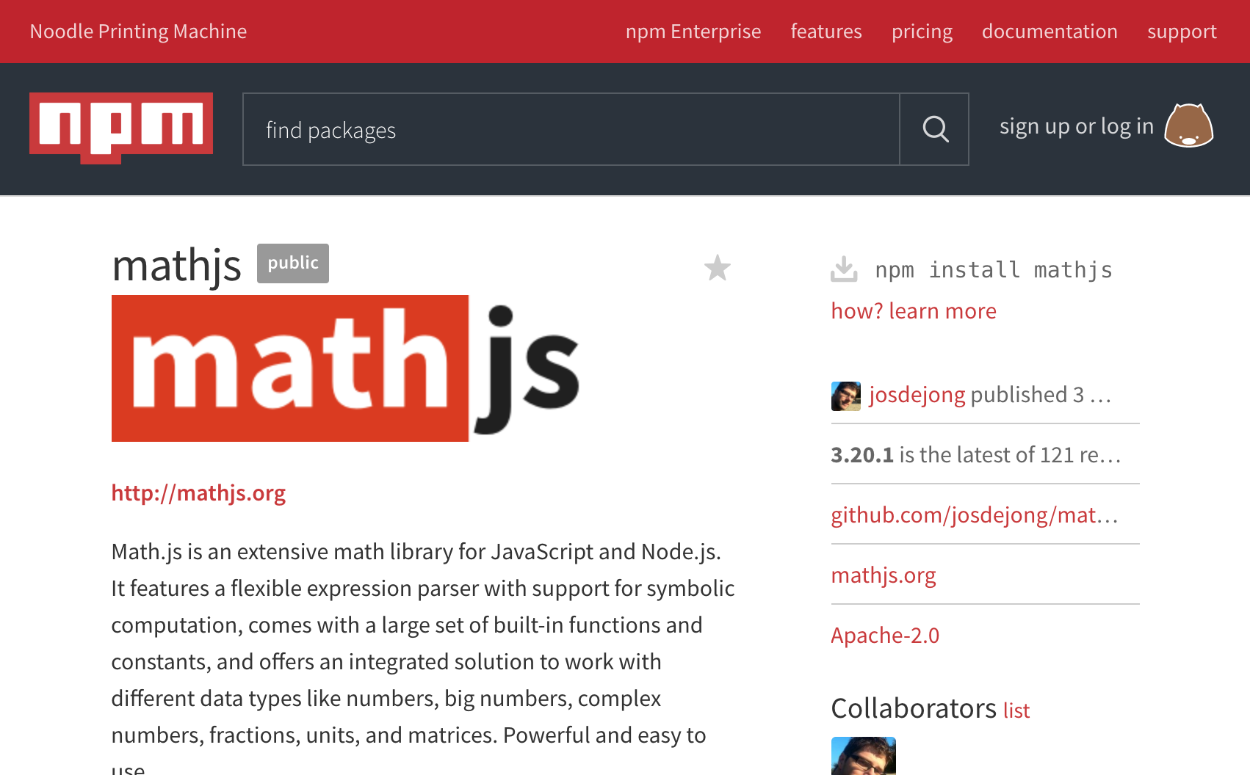
https://www.npmjs.com
> npm install mathjs
Node Package Manager
Notes:
Included in the Node.js installation is the Node Package Manager, or NPM. Many people have argued that the reason for Node.js’s success isn’t so much the runtime environment itself, but NPM with it’s centralised package repository and it’s simple way of handling dependencies. Here’s a screenshot of the NPM repository in a web browser where I searched for a maths library and found a particularly popular one, mathjs. And with one simple command I can install it into by project. But I’m getting ahead of myself - first we need to see the anatomy of a Node.js project.

Slide 11
app
|-package.json
|-package-lock.json
|-node_modules
|-mathjs
|-...
|-mocha
|-...
|-src
|-main.js
|-lib.js
|-lib.test.js
Node.js Project
Notes:
Here’s a basic outline of a node project in the directory app. Every project has a project.json file which is a high level descriptor of the project and will typically be the first thing you create. Then we have package-lock.json. You don’t write this yourself, it is automatically updated whenever you install a package with the specific package version so that when you deploy the project to a different location you can reliably retrieve the exact same dependencies. node_modules is the directory where third party packages are installed when you run npm install. While it’s possible to install packages globally, installing to a specific project helps prevent against conflicts and makes it clear what version of packages you are using. In here we can see that there is a mathjs directory in addition to another package called mocha which I will explain later.
Finally we have the source directory, where we will write our own code. It doesn’t have to be in a directory called source, but that’s how it is usually done. How you organise your code in this directory is up to you. Here we have 3 scripts which we’ll have a look at in a moment.

Slide 12
{
"name": "basicapp",
"version": "0.0.1",
"description": "A basic app to showcase NodeJS.",
"author": "Jan Czarnecki",
"dependencies": {
"mathjs": "^3.20.1",
"mocha": "^5.0.0”
},
"scripts": {
"main": "node src/main.js",
"test": "mocha \"./src/**/*.test.js\""
}
}
package.json
Notes:
This is the package.json file. There are a great many fields that can be included in this file, here I’ve picked out some of the most important one. We have some basic descriptors at the top until we come to the dependencies field. Whenever you run npm install the latest version of the package will be downloaded to node_modules and package.json will updated to include it. Version specifications are typically non-specific - the caret here specifies when I update the packages, so long as mathjs is still at version 3 it will download the latest version. As if just the second or third number change, it means that there hasn’t been any breaking changes. Package-lock.json is updated with the specific version that has been installed.
Finally here we have defined a couple of scripts. This is a good way of organising your development scripts and we’ll be looking at these more soon.

Slide 13
Demo init

Slide 14
app
|-package.json
|-package-lock.json
|-node_modules
|-mathjs
|-...
|-mocha
|-...
|-src
|-main.js
|-lib.js
|-lib.test.js
Node.js Project
Notes:
So that explains setting up the project folder and installing dependencies, now how do we actually write code. Let’s have a look at lib and main js.

Slide 15
var math = require('mathjs');
module.exports.calculateCircleArea = function(radius) {
return math.pi * math.square(radius);
}
module.exports.calculateSphereVolume = function(radius) {
return (4/3) * math.pi * math.cube(radius);
}
lib.js
Notes:
This is lib.js - a basic library of functions. First I’ve imported mathjs into the code using this require syntax. Whenever node.js encounters a require function, if it’s not a relative path it will climb the directories until it reaches a node_modules directory and looks for the module in there. Mathjs returns an object which I have named math. And if we want to know what this object can do, we can consult the specification on the NPM or the GitHub project.
Next I’m creating a function which will calculate the area of a circle. I’ve assigned it to a field in the exports object which allows it to be used by a different file - you’ll see how in a second. In the function I’m accessing the pi field of math (which is a constant) and the square field, which is a function. Finally I’ve created a second function to calculate the volume of a sphere.

Slide 16
var lib = require('./lib');
console.log(
'The area of a circle with radius 5 is '
+ lib.calculateCircleArea(5)
);
console.log(
'The volume of a sphere with radius 5 is '
+ lib.calculateSphereVolume(5)
);
main.js
Notes:
Here’s the main script. First we import lib. When a relative path is used Node looks for the file relative to this file. And here I’m simply printing out the result of each function to the command line. Let’s have a look at how it runs.

Slide 17
Demo BasicApp

Slide 18
app
|-package.json
|-package-lock.json
|-node_modules
|-mathjs
|-...
|-mocha
|-...
|-src
|-main.js
|-lib.js
|-lib.test.js
Node.js Project
Notes:
So this is a way of organising a project that is probably much closer to how you manage projects in other languages and a very long way from our long list of imported Javascript files at the top of our HTML. One very practical reason for wanting to organise your code like this is the ease of testing. For this I have installed mocha, which is one of the more popular Javascript test runners, and I written a test file for lib. Let’s have a look.

Slide 19
var assert = require('assert');
var lib = require('./lib');
describe('lib', function() {
describe('#calculateCircleArea', function() {
it('should return the correct value when the radius is positive', function() {
assert.equal(lib.calculateCircleArea(5), 78.53981633974483);
});
it('should throw an error when the radius is negative', function() {
assert.throws(function() {
lib.calculateCircleArea(-1)
}, Error);
});
});
});
lib.test.js
Notes:
First we import the node assertions library and our file that we are testing. We use these describe and it functions to organise our tests (this is important for displaying the results). So we’re testing lib, specifically the calculateCircleArea function and it should return the correct value when the radius entered is positive so we assert that the output from the function is the same as this precalculated value. We have a second test that states that the function should throw an error when a negative radius is used.

Slide 20
{ "name": "basicapp", "version": "0.0.1", "description": "A basic app to showcase NodeJS.", "author": "Jan Czarnecki", "dependencies": { "mathjs": "^3.20.1",
"mocha": "^5.0.0" }, "scripts": { "main": "node src/main.js",
"test": "mocha \"./src/**/*.test.js\"" } }
package.json
Notes:
Then, if I remind you of the script in package.json, we just need to run mocha and give it a glob pattern for the test files. As I stated, when running one of these scripts it looks in node_modules for the program, so we don’t have to install mocha globally. Let’s see how that works.

Slide 21
Demo BasicApp testing

Slide 22
What do we need?
A way of developing modular code on the server that is easy to maintain and test. ✓
A way of building a consolidated script that can be easily deployed to the client.
A way of cleanly manipulating HTML.
Notes:
So, we’ve seen a way that we can write Javascript sensibly that we can organise how we like and how to test it. But we can’t run the code we’ve seen in the browser. Exporting code and then requiring external code is not something that browsers understand. And anyway, we would like to consolidate all the code into one file as that is the most efficient way of delivering it to the client. So now we going to look at how to do just that.

Slide 23
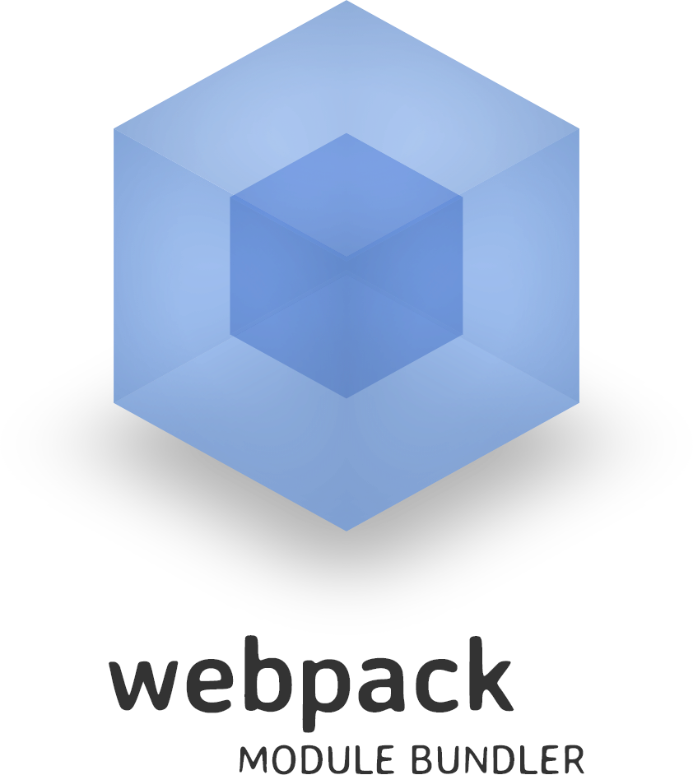
app
|-webpack.config.js
|-package.json
|-package-lock.json
|-node_modules
|-mathjs
|-...
|-src
|-main.js
|-lib.js
bundle.js
npm install webpack
webpack --config ./webpack.config.js
Webpack
Notes:
There’s a tool that allows us to do just that called Webpack. We provide Webpack with a configuration file and and it’s able to convert our Node.js project into a single Javascript file. As with every other package we simply install webpack the usual way and can then run it on the command line.

Slide 24
var webpack = require('webpack');
var path = require('path');
module.exports = {
entry: [
path.join(__dirname, 'src/main.js')
],
output: {
path: path.join(__dirname, '/dist'),
filename: 'bundle.js'
},
module: {
rules: []
}
}
webpack.config.js
Notes:
The is the webpack config file and they can get quite complex as your project gets more complex, but we can go through the basics.
The config file is actually a script, which is handy because we can import modules and make the configuration dynamic if we want. But the script must export an object which has 2 fields, entry and output. Entry is an array of paths to the entry scripts. Here we are pointing it to main.js - the script we’ve been running previously. Output describes where to put the final built script. We’re telling it to put it into the directory dist and to call it bundle.js. I’ve also included the module field here, but I’ll come back to this.

Slide 25
{ "name": "basicapp", "version": "0.0.1", "description": "A basic app to showcase NodeJS.", "main": "index.js", "author": "Jan Czarnecki", "dependencies": { "mathjs": "^3.20.1",
"webpack": "^3.10.0" }, "scripts": { "main": "node dist/bundle.js",
"build": "webpack --config ./webpack.config.js" } }
package.json
Notes:
This is our package.json. You can see we’ve added a build script which runs webpack, telling it the location of the config file. And we’ve also changed the main script so that it runs bundle.js. Let’s see how it runs.

Slide 26
Demo WebpackBasic

Slide 27
app
|-package.json
|-package-lock.json
|-webpack.config.js
|-node_modules
|-src
|-main.js
|-lib.js
|-server.js
|-index.html
Web application
Notes:
It’s still not a web application, though. There’s a few changes that we have to make to display the results in a web browser. I’ve made changes to main.js and added server.js and index.html. Let’s see what’s in them.

Slide 28
<html>
<head>
<title>Shapes</title>
<script src="static/bundle.js"></script>
</head>
<body>
<section>
The area of a circle with radius
<input id='circle_input' type='text' />cm is
<span id='circle_output'>N/A</span>cm<sup>2</sup>.
</section>
</body>
</html>
index.html
Notes:
This is the HTML that will be sent to the client. It’s largely the same as the page we saw right at the start. The most important bits are the input here, where the user will enter a number, and the output here where the calculated area will be displayed.
We’ve specified the script here, but we’re entered the path static/bundle.js. I’ll explain that in a second.

Slide 29
var lib = require('./lib');
document.addEventListener('DOMContentLoaded', function() { var circleInput = document.getElementById('circle_input'); circleInput.addEventListener('change', setCircleOutputContent);
}
function setCircleOutputContent(event) {
var output = document.getElementById('circle_output');
output.innerHTML = lib.calculateCircleArea(event.target.value);
}
main.js
Notes:
I’ve then changed main.js so that the appropriate event listeners are set. Once again, this is similar to the script that we had right at the start. We wait for the document to load, add a change listener to the input element that runs this function. The function calculates the area from the value of the input and puts it into the output element.

Slide 30
var express = require('express');
var path = require('path');
var app = express();
app.get('/', function(req, res) {
res.sendFile(path.join(__dirname, 'index.html'));
});
app.use('/static', express.static('dist'));
app.listen(3000, function() {
console.log('WebApp listening on port 3000!')
});
server.js
Notes:
Finally we need a web server that can deliver the HTML and Javascript file. It’s really easy to start up a web server in Node - as I mentioned earlier, this was the original use case for it. So we need to install this package called Express - there’s a number of web servers available, but Express is the most popular. We create a new instance and then say that if somebody makes a GET request to the root path of the server, then return the HTML file that I showed you. And then I’ve mounted the dist directory to the path slash static. So if you go make a request to /static/bundle.js, like we have done in the HTML file, it will return dist/bundle.js.
Finally, we tell the server to listen for requests on port 3000. Let’s see how this goes.

Slide 31
Demo WebApp

Slide 32

Release updated C# specification
Release updated libraries and runtime
Release updated Visual Studio
C#
Notes:
Now the previous example shows you enough to get going and to begin setting up web application projects. However, there’s one other important thing to show you all before you start coding and it will be particularly relevant to next week’s presentation on React. Webpack isn’t just about compiling multiple scripts into a single script - it can also preprocess code using plugins. To understand why this is important we need to understand how the Javascript language updates over time.
First let’s consider a different language: C sharp. The language is developed by Microsoft and when Microsoft releases a updated language specification they will also release an updated runtime, compatible libraries, maybe even a new version of Visual Studio if necessary. So when a new version of C# is released you can jump right in and start developing with it. The story with Javascript is a little more complicated, however.

Slide 33





Releases new ECMAScript specification
ECMAScript
Notes:
The standards body ECMA International, which is made up of many diverse members, hammers out a specification for ECMAScript, releases it and then does… nothing. It’s then up to the different web browser developers, the big ones being Google, Mozilla, Microsoft and Apple to implement this specification as Javascript. This is why when you’re investigating different Javascript versions you’ll often see it referred to as ECMAScript or ES for short. The latest ECMAScript specification, ES2017 was published in June last year, but it will take some time for all the browsers to implement all the features, and old browsers, such as Internet Explorer 11, will never get them.
So, can we use these features? Or do we have to wait until nobody is using Internet Explorer anymore. Thankfully, the ability to preprocess code allows us to use the new specification while still supporting older browsers.

Slide 34

Modern Javascript
> babel src -d lib
Specific browser version compatible Javascript
Babel
Notes:
The tool we are going to use to convert modern Javascript code to browser compatible Javascript is Babel. While we can use Babel on the command line to convert files, it’s easier to simply use it from within Webpack.

Slide 35
{ "name": "basicapp", "version": "0.0.1", "description": "A basic app to showcase NodeJS.", "main": "index.js", "author": "Jan Czarnecki", "dependencies": {
"babel-core": "^6.26.0",
"babel-loader": "^7.1.2",
"babel-preset-env": "^1.6.1",
"express": "^4.16.2", "mathjs": "^3.20.1",
"webpack": "^3.10.0" }, "scripts": { "main": "node dist/bundle.js",
"build": "webpack --config ./webpack.config.js" } }
package.json
Notes:
We need to first install these 3 packages - Babel is designed in a very modular way. Babel-core, which, as the name suggests, is the package containing the core babel functionality. Babel-loader, which is the plugin that connects babel-core to Webpack. And babel-preset-env, which contains version information for different browsers so that Babel knows how far back it needs to convert the Javascript.

Slide 36
var webpack = require('webpack'); var path = require('path'); module.exports = { entry: [ path.join(__dirname, 'src/main.js') ], output: { path: path.join(__dirname, '/dist'), filename: 'bundle.js' },
module: {
rules: []
}
}
webpack.config.js
Notes:
As a reminder, this is the Webpack config file. We’re going to add a rule in here which will explain what we want Babel to do.

Slide 37
{
test: /\.js$/,
exclude: /node_modules/,
loader: 'babel-loader',
options: {
"presets": [
["env", {
targets: {
browsers: ['last 2 versions']
}
}]
]
}
}
webpack.config.js
Notes:
What this rule states is that for every file that matches this regular expression, i.e. Javascript files, but excluding files in node_modules, give them to Babel first. And we tell Babel that we want the script to be able to run on the last 2 versions of every browser. This doesn’t work in all cases - it’s impossible to backport modern Javascript to Internet Explorer 6, for instance, but it takes away most of worries of compatibility. You can feel free to use the current language spec and let Babel worry about it. As browsers are updated, so are the Babel presets and it will change how the code is processed automatically.

Slide 38
Demo WebAppBabel

Slide 39
interface GreetingSettings { greeting: string; duration?: number; color?: string; } declare function greet(setting: GreetingSettings): void;
Typescript
Notes:
This processing of files is very powerful and allows us to handle more than just different Javascript versions. For instance, Microsoft released Typescript, which is a statically typed superset of Javascript which has become very popular. Similarly to Babel there is a Webpack plugin that allows this to be built into standard Javascript.

Slide 40
import React from 'react'; import PropTypes from 'prop-types'; import './Display.css'; class Display extends React.Component { render() { return ( <div className="component-display"> <div> {this.props.value} </div> </div> ); } } Display.propTypes = { value: PropTypes.string, }; export default Display;
React
Notes:
And as a little taster for next week, here’s a React file which incorporates HTML within Javascript. Again Webpack will be able to process these files and convert them to standard Javascript.

Slide 41
What do we need?
A way of developing modular code on the server that is easy to maintain and test. ✓
A way of building a consolidated script that can be easily deployed to the client. ✓
A way of cleanly manipulating HTML...
Notes:
So we’ve completed step 2, we can now develop modular, maintainable code and we can build this code, regardless of the version of the language spec we are using into a single script that can be run by the client. The next step is finding a better way of working with HTML than the low level APIs I’ve demonstrated previously. There are a number of different frameworks which you can use, but next week, same time and place, Richard will be introducing one of the more popular ones, React. So if you want to learn how to do something useful with what I shown you today, make sure you’re here next week.

Slide 42



Thank you for listening!
https://github.com/janczarn/igm_talk
jc37@sanger.ac.uk

